Slide 1
How to compress the pressure data?
Mingkai Peng

Slide 2
Raw data in the test file
Time: 29 hours
Frame: every second, in total: 104476 frames
File size: 2.71 GB

Slide 3
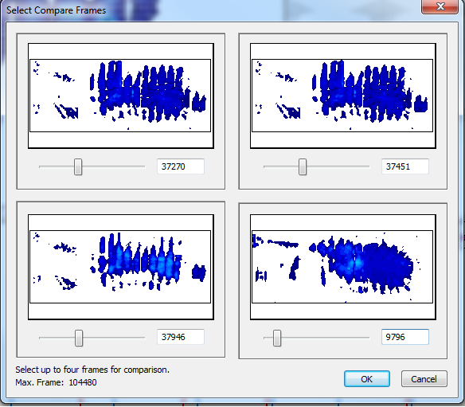
Correlation between different frames
Coefficient of correlation between different frames:
37270 vs 37451: 0.993
37270 vs 37946: 0.732
37372 vs 9796: 0.612

Slide 4
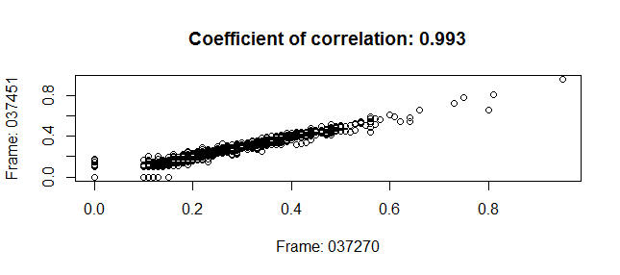
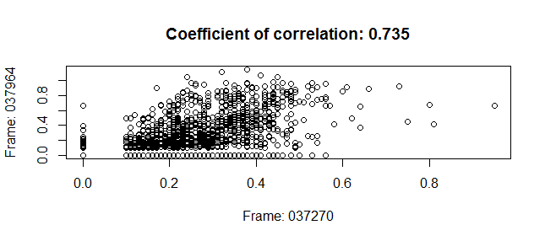
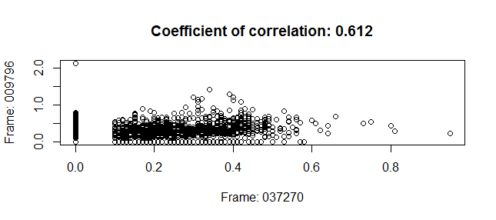
Scatter plot:

Slide 5
Data compression:
Different sampling frequency: every 5s (20895), 10s (10467), and 20s(5223).
Calculate the correlation coefficient between adjacent frames and find the appropriate threshold of correlation coefficient to detect the change of patient position.

Slide 6
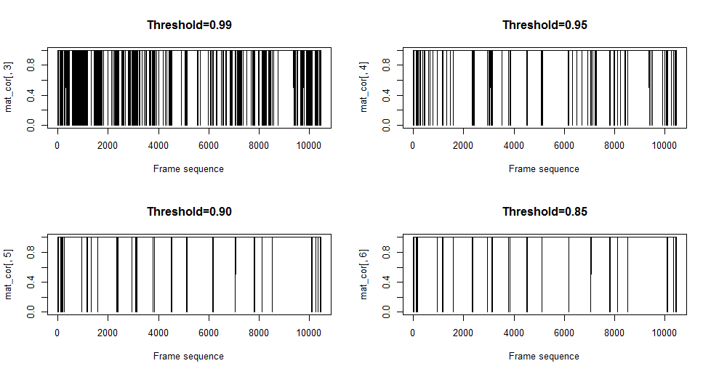
Sampled at every 10s, different threshold of correlation coefficent:

Slide 7
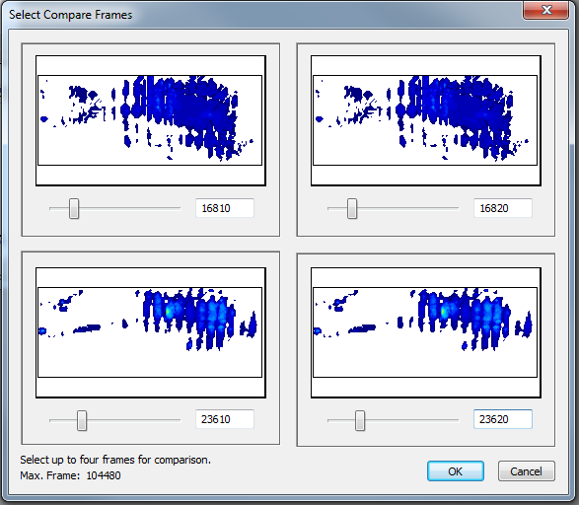
Frames with correlation coefficient between 0.95 and 0.99
Correlation coefficient:
16810 vs 16820: 0.98
23610 vs 23620: 0.989

Slide 8
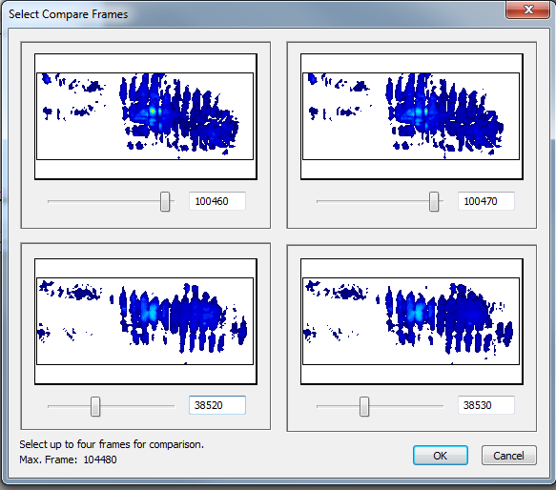
Frames with correlation coefficient between 0.90 and 0.95
Correlation coefficient:
100570 vs 100580: 0.949
38420 vs 38430: 0.944

Slide 9
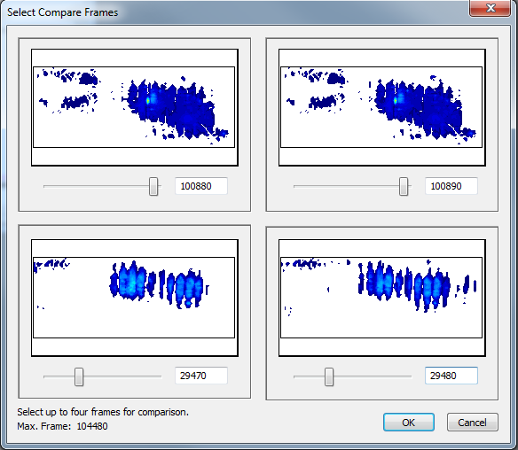
Frames with correlation coefficient between 0.85 and 0.90
Correlation coefficient:
100880 vs 100890: 0.889
29470 vs 29480: 0.865

Slide 10
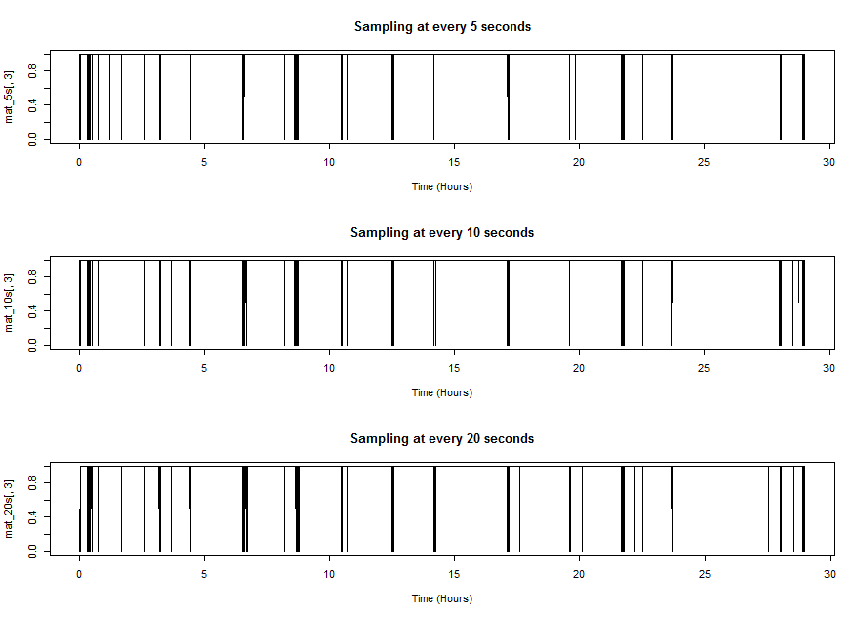
Sampled at 5s,10s, and 20s, threshold >0.9

Slide 11
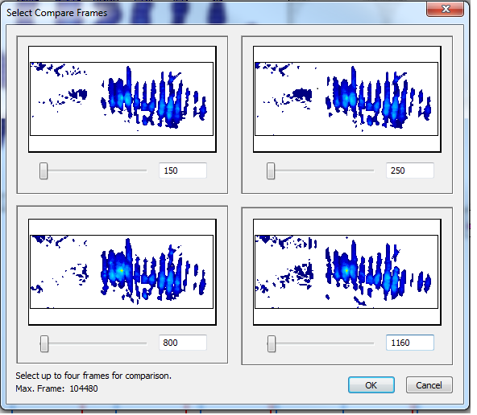
Combined the frames from 15 to 117, sampled at every 10s.

Slide 12
Notes:
How to distinguish different position

Slide 13
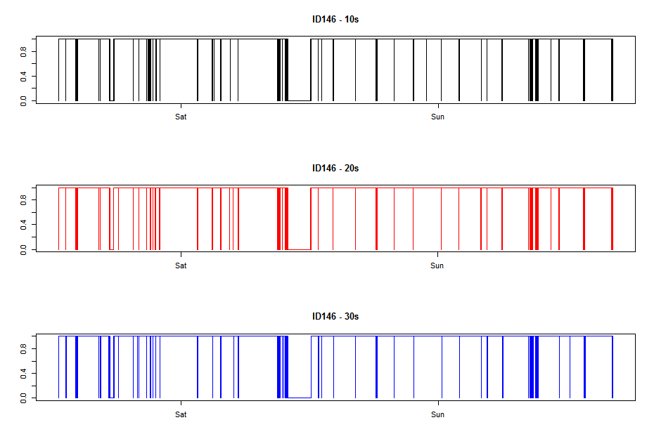
ID 146

Slide 14
ID:146

Slide 15
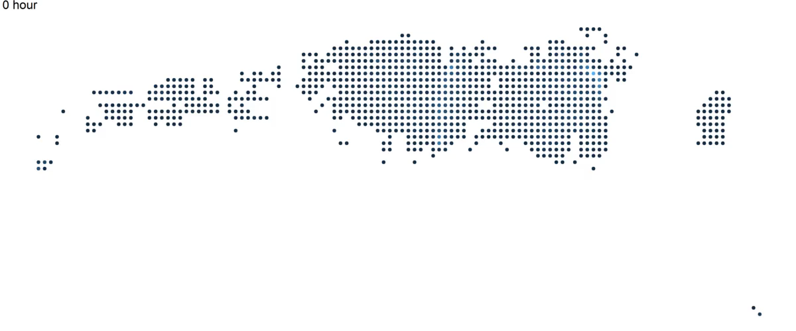
ID:146
Notes:
207 frames

Slide 16
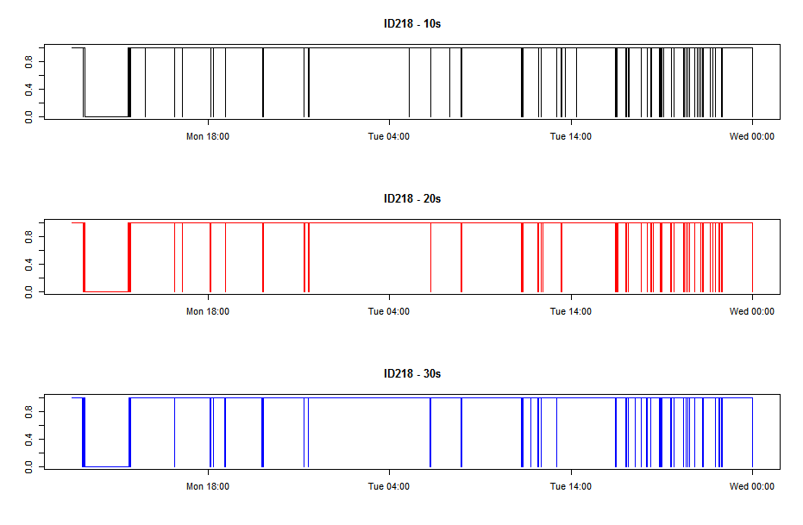
ID 218

Slide 17
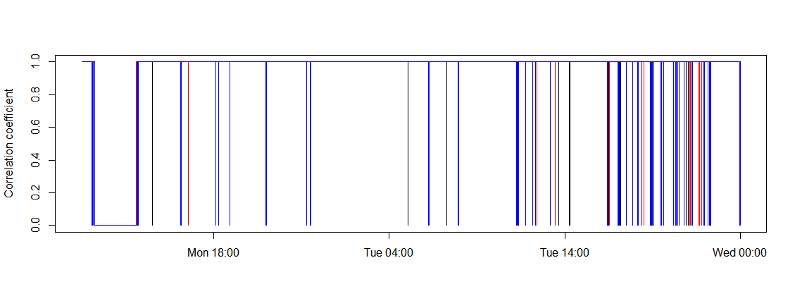
ID 218
Notes:
133 frames

Slide 18
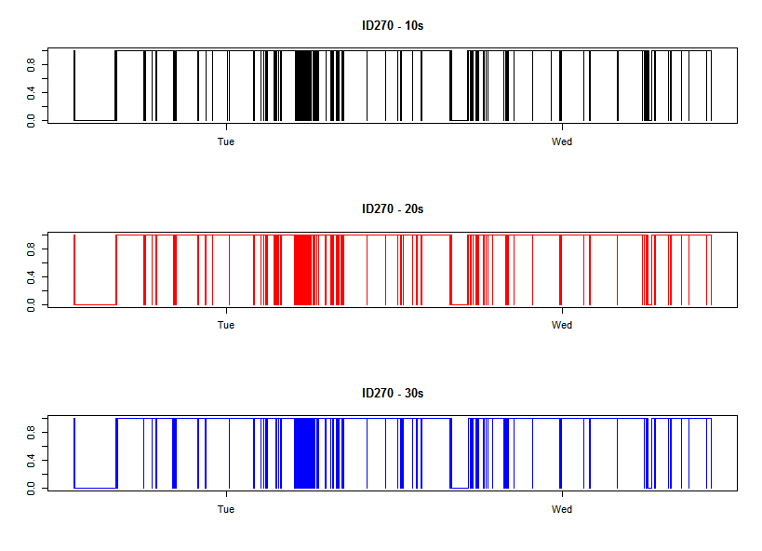
ID270

Slide 19
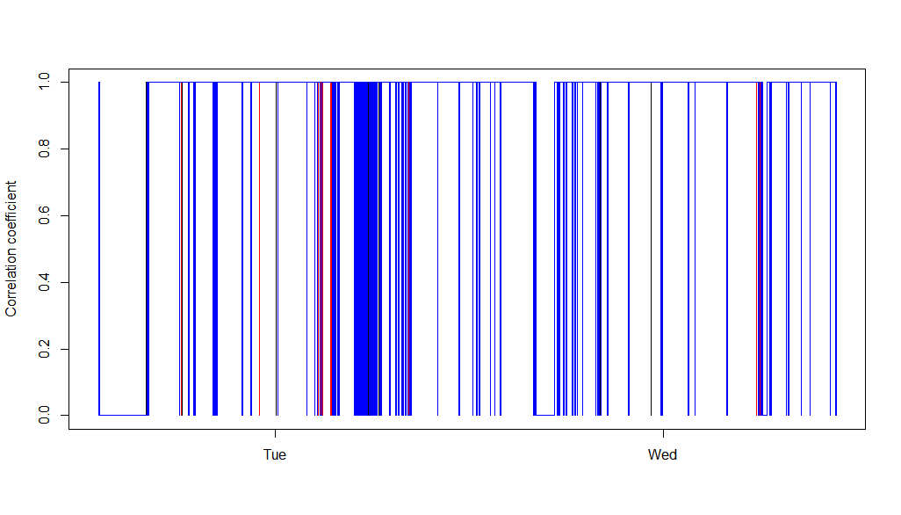
ID: 270

Slide 20
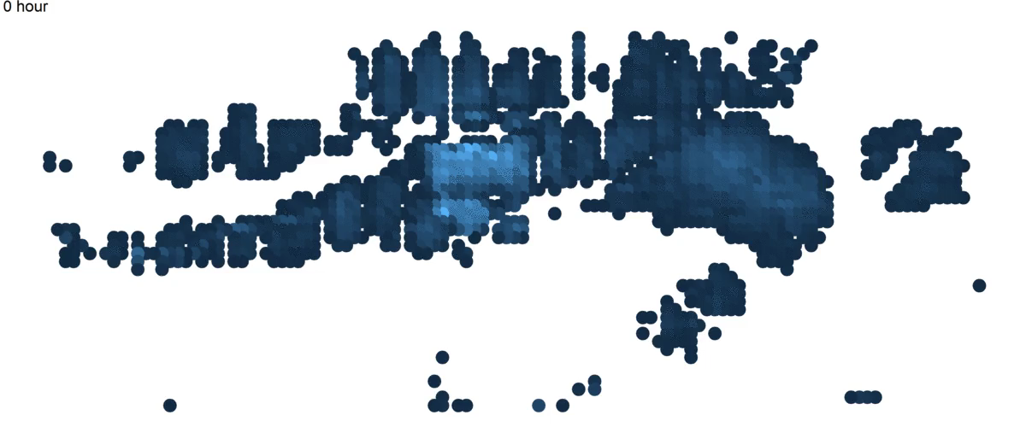
ID: 270
Notes:
374 frames

